Slide 1
Healthcare Data analytics by Dr. Samuel Israel 10/11/2024

Slide 2
About me
Name: Dr. Samuel Israel
MB,BS
Business Analyst
Data & Business Intelligence Analyst
Product Manager

Slide 3
objective
Assessment of adequate filling of radiology request by referring clinicians at NAUTH, Nigeria

Slide 4
analysis
1. Analysis of adequately filled field:
Shows that sex and name were top in this list.
Address was the least of adequately filled field
2. Analysis of inadequately filled fields:
Clinical information was top in this list
Age and X-ray number were the least of inadequately filled field.

Slide 5
Recommendation
Conduct root cause analysis to understand why forms are not being adequately filled and develop specific measures to address these reasons.
Conduct regular training and workshops for clinicians focusing on the importance of adequately filling out request forms
Case studies to illustrate the consequences of inadequate information on request forms with emphasis on potential diagnostic errors, delays , or medicolegal issues
Design radiology request form with simplified and mandatory fields to minimize the chances of omission.
Integrate radiology request forms into the hospital’s EHR system with automated reminders or prompts to guide clinicians
Interdisciplinary rounds, communication and collaboration between radiologists and clinicians

Slide 6
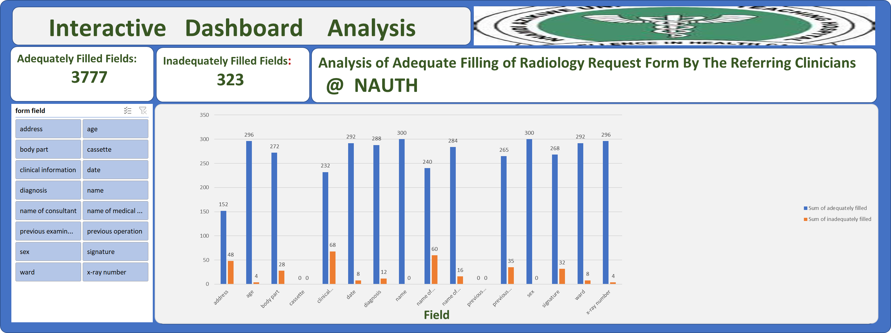
Interactive dashboard analysis

Slide 7
Thank you
@drsamisrael/healthcare data analytics

